Slide 1
Introduction to Web Crawling
Ramesh Ragala
Assistant Professor (Senior)
VIT Chennai

Slide 2
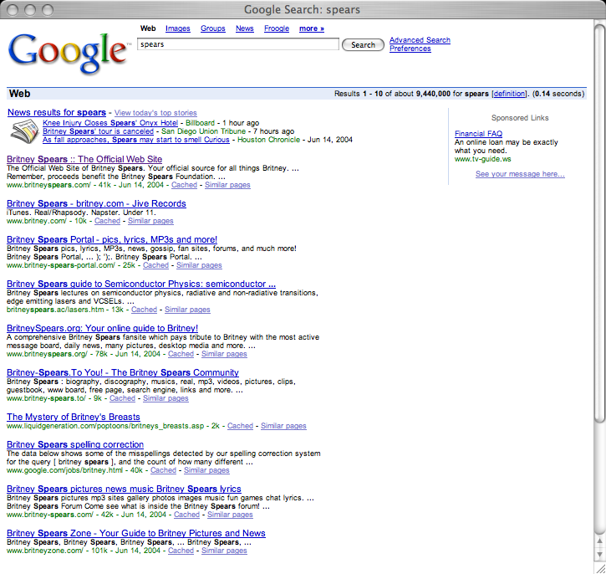
Web Crawling
Q: How does a search engine know that all these pages contain the query terms?
A: Because all of those pages have been crawled
<number>

Slide 3
Web Crawling
Web Crawlers are programs that automatically download web pages.
Web search is the quintessential large-data problem.
Many Names
Crawler
Spider
Robot (or bot)
Web agent
Wanderer, worm, …
And famous instances: googlebot, scooter, slurp, msnbot, …
<number>

Slide 4
Web Crawling
Web Crawlers are programs that automatically download web pages.
A crawler can visit many sites to collect information that can be analyzed and mined in a central location, either online (as it is downloaded) or off-line (after it is stored).
Simply, Crawling is the process by which search engines discover updated content on the web, such as new sites or pages, changes to existing sites and dead links.
<number>

Slide 5
Web Crawling
Given an information need expressed as a short query consisting of a few terms, the system's task is to retrieve relevant web objects and present them to the user.
Web objects:
web pages
PDF documents
PowerPoint slides, etc.
It is difficult to compute exactly, but even a conservative estimate would place the size at several tens of billions of pages, totaling hundreds of terabytes .
User will expect results in quick manner
<number>

Slide 6
Web Crawling
Applications:
Support universal search engines (Google, Yahoo, MSN/Windows Live, Ask, etc.)
Vertical (specialized) search engines, e.g. news, shopping, papers, recipes, reviews, etc.
Business Intelligence: keep track of potential competitors, partners
Monitor Web pages and give notification to users or community
Phishing, spamming,etc
<number>

Slide 7

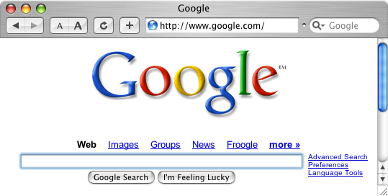
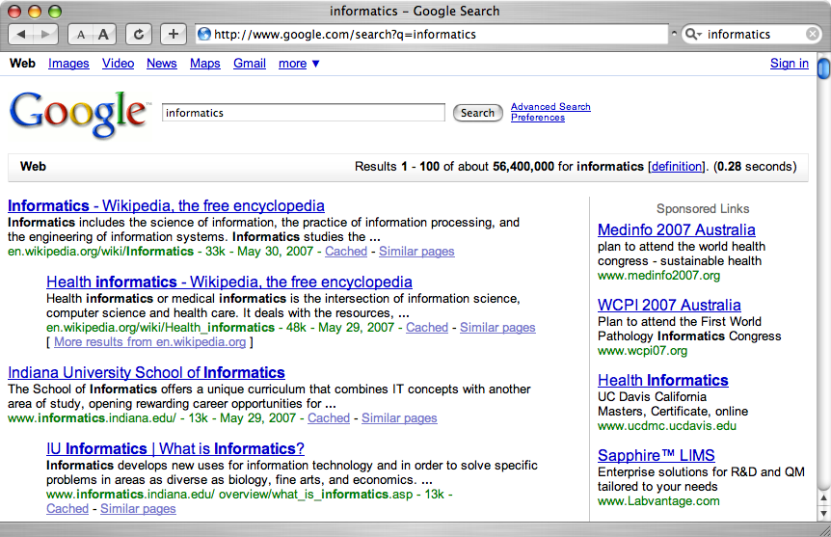
A crawler within a search engine
Web
Page repository
googlebot
Text & link analysis
Query
hits
Text index
PageRank
Ranker
Notes:
1

Slide 8
Web Crawling
Web Crawlers are used to support search engines.
Crawlers are main consumers of Internet bandwidth
Web crawlers collect pages for search engines to build their indexes.
Nearly all retrieval engines for full-text search today rely on a data structure called an inverted index, which given a term provides access to the list of documents that contain the term
In information retrieval parlance, objects to be retrieved are generically called “documents"
<number>

Slide 9
Web Crawling
Given a user query, the retrieval engine uses the inverted index to score documents that contain the query terms with respect to some ranking model, taking into account features such as term matches, term proximity, attributes of the terms in the document as well as the hyperlink structure of the documents.
The web search problem decomposes into three components:
1. gathering web content (crawling).
2. construction of the inverted index (indexing)
3. ranking documents given a query (retrieval).
Crawling and indexing share similar characteristics and requirements, but these are very different from retrieval.
<number>

Slide 10
Web Crawling
Gathering web content and building inverted indexes are for the most part offline problems.
Indexing is usually a batch process that runs periodically: the frequency of refreshes and updates is usually dependent on the design of the crawler
Retrieval is an online problem that demands sub-second response time.
Individual users expect low query latencies, but query throughput is equally important since a retrieval engine must usually serve many users concurrently.
<number>

Slide 11
Web Crawling
Gathering web content and building inverted indexes are for the most part offline problems.
However, effective and efficient web crawling is far more far more complex. The following lists a number of issues that real-world crawlers must contend with:
1. A web crawler must practice good “etiquette" and not overload web servers. For example, it is common practice to wait a fixed amount of time before repeated requests to the same server. In order to respect these constraints while maintaining good throughput, a crawler typically keeps many execution threads running in parallel and maintains many TCP connections (perhaps hundreds) open at the same time.
<number>

Slide 12
Web Crawling
2. Since a crawler has finite bandwidth and resources, it must prioritize the order in which unvisited pages are downloaded. Such decisions must be made online and in an adversarial environment, in the sense that spammers actively create “link farms" and “spider traps" full of spam pages to trick a crawler into overrepresenting content from a particular site.
3. Most real-world web crawlers are distributed systems that run on clusters of machines, often geographically distributed. To avoid downloading a page multiple times and to ensure data consistency, the crawler as a whole needs mechanisms for coordination and load-balancing. It also needs to be robust with respect to machine failures, network outages, and errors of various types.
<number>

Slide 13
Web Crawling
4. Web content changes, but with different frequency depending on both the site and the nature of the content. A web crawler needs to learn these update patterns to ensure that content is reasonably current. Getting the right recrawl frequency is tricky: too frequent means wasted resources, but not frequent enough leads to stale content.
5. The web is full of duplicate content. Examples include multiple copies of a popular conference paper, mirrors of frequently-accessed sites such as Wikipedia, and newswire content that is often duplicated. The problem is compounded by the fact that most repetitious pages are not exact duplicates but near duplicates (that is, basically the same page but with different ads, navigation bars, etc.) It is desirable during the crawling process to identify near duplicates and select the best exemplar to index.
<number>

Slide 14
Web Crawling
6. The web is multilingual. There is no guarantee that pages in one language only link to pages in the same language. For example, a professor in Asia may maintain her website in the local language, but contain links to publications in English. Furthermore, many pages contain a mix of text in different languages. Since document processing techniques (e.g., tokenization, stemming) differ by language, it is important to identify the (dominant) language on a page.
<number>

Slide 15
Inverted Index
An inverted index consists of postings lists, one associated with each term that appears in the collection.
A postings list is comprised of individual postings, each of which consists of a document id and a payload -- information about occurrences of the term in the document.
The simplest payload is. . . Nothing
For simple Boolean retrieval, no additional information is needed in the posting other than the document id; the existence of the posting itself indicates that presence of the term in the document.
<number>

Slide 16
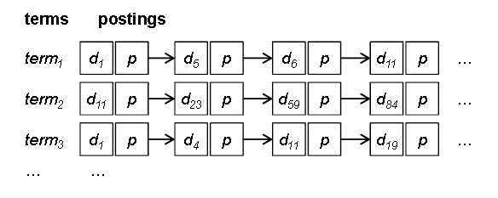
Inverted Index
<number>

Slide 17
Inverted Index
The most common payload, however, is term frequency (tf), or the number of times the term occurs in the document.
More complex payloads include positions of every occurrence of the term in the documents, properties of the term, or even the results of additional linguistic processing.
Given a query, retrieval involves fetching postings lists associated with query terms and traversing the postings to compute the result set.
In the simplest case, Boolean retrieval involves set operations (union for Boolean OR and intersection for Boolean AND) on postings lists, which can be accomplished very efficiently since the postings are sorted by document id.
<number>

Slide 18
Inverted Index
In the general case, however, query - document scores must be computed.
Partial document scores are stored in structures called accumulators.
At the end the top k documents are then extracted to yield a ranked list of results for the user. Of course, there are many optimization strategies for query evaluation (both approximate and exact) that reduce the number of postings a retrieval engine must examine.
The size of an inverted index varies, depending on the payload stored in each posting.
<number>

Slide 19
Inverted Index using MapReduce : Baseline Inverted Index
Input to the mapper consists of document ids (keys) paired with the actual content (values).
Individual documents are processed in parallel by the mappers.
Each document is analyzed and broken down into its component terms.
Once the document has been analyzed, term frequencies are computed by iterating over all the terms and keeping track of counts.
Lines 4 and 5 in the pseudo-code reflect the process of computing term frequencies, but hides the details of document processing
<number>

Slide 20
Inverted Index using MapReduce : Baseline Inverted Index
After this histogram has been built, the mapper then iterates over all terms.
Each term, a pair consisting of the document id and the term frequency is created.
Each pair, denoted by {n;H{t}} in the pseudo-code, represents an individual posting.
The mapper then emits an intermediate key-value pair with the term as the key and the posting as the value, in line 7 of the mapper pseudo-code.
<number>

Slide 21
Inverted Index using MapReduce : Baseline Inverted Index
In the shuffle and sort phase, the MapReduce runtime essentially performs a large, distributed group by of the postings by term.
Without any additional effort by the programmer, the execution framework brings together all the postings that belong in the same postings list.
This tremendously simplifies the task of the reducer, which simply needs to gather together all the postings and write them to disk.
The reducer begins by initializing an empty list and then appends all postings associated with the same key (term) to the list.
The postings are then sorted by document id, and the entire postings list is emitted as a value, with the term as the key.
<number>

Slide 22
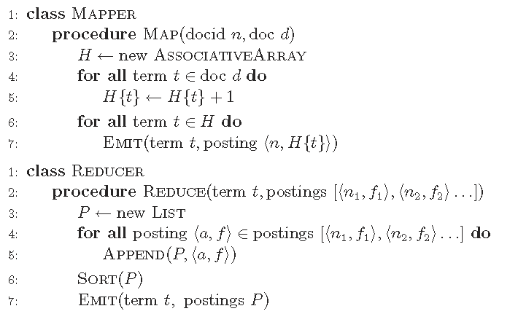
Inverted Index using MapReduce : Baseline Inverted Index
<number>

Slide 23
Inverted Index using MapReduce : RevisedBaseline Inverted Index
There is a significant scalability bottleneck is available in Baseline Inverted Index algorithm.
The algorithm assumes that there is sufficient memory to hold all postings associated with the same term.
For efficient retrieval, postings need to be sorted by document id.
The basic MapReduce execution framework makes no guarantees about the ordering of values associated with the same key, the reducer first buffers all postings and then performs an in-memory sort before writing the postings to disk.
However, as collections become larger, postings lists grow longer, and at some point in time, reducers will run out of memory.
<number>

Slide 24
Inverted Index using MapReduce : RevisedBaseline Inverted Index
Solution to this problem:
Since the execution framework guarantees that keys arrive at each reducer in sorted order, one way to overcome the scalability bottleneck is to let the MapReduce runtime do the sorting for us.
Instead of emitting key-value pairs of the following type: (term t, posting {docid, f}), we emit intermediate key-value pairs of the type instead: (tuple {t,docid}, tf f).
That is the key is a tuple containing the term and the document ID, whereas the value is the term frequency .
With this modification, the postings are arrives in the correct order.
This, combined with the fact that reducers can hold state across multiple keys, allows postings lists to be created with minimal memory usage.
So, we must define a custom partitioner to ensure that all tuples with the same term are shuffled to the same reducer.
<number>

Slide 25
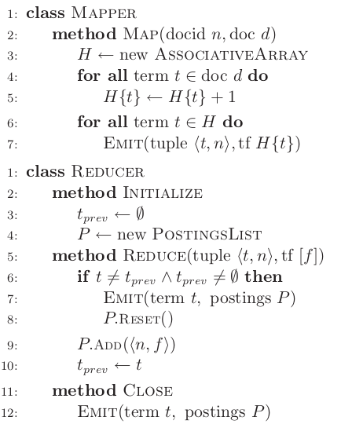
Inverted Index using MapReduce : RevisedBaseline Inverted Index
<number>

Slide 26
Inverted Index using MapReduce : RevisedBaseline Inverted Index
Solution to this problem:
Since the execution framework guarantees that keys arrive at each reducer in sorted order, one way to overcome the scalability bottleneck is to let the MapReduce runtime do the sorting for us.
Instead of emitting key-value pairs of the following type: (term t, posting {docid, f}), we emit intermediate key-value pairs of the type instead: (tuple {t,docid}, tf f).
That is the key is a tuple containing the term and the document ID, whereas the value is the term frequency .
With this modification, the postings are arrives in the correct order.
This, combined with the fact that reducers can hold state across multiple keys, allows postings lists to be created with minimal memory usage.
So, we must define a custom partitioner to ensure that all tuples with the same term are shuffled to the same reducer.
<number>

